Slide 1
BWR-model exercises
BWR-model exercises

Slide 2
The model
BWR-model exercises
Parameter | Value
Reactor thermal power | 2550 MW (102 % of nominal power)
Reactor pressure | 70 bar
Reactor vessel water level | 4.3 m
Recirculation flow rate | 7600 kg/s
Steam flow rate | 4 * 327 kg/s

Slide 3
Extent of the model
BWR-model exercises
The following main systems have been modelled:
reactor vessel (211) including a 1D-core and six internal recirculation pumps (313)
steam lines from reactor vessel to turbine control and turbine bypass valves (311, 413)
relief system (314) for steam blowdown to containment condensation pool
containment (151) with upper and lower drywell and wetwell with condensation pool (316)
core spray system (323) and auxiliary feed water system (327) for ECC
containment spray system (322) connected to shutdown secondary cooling system (721) and shutdown service water system (712) for condensation pool cooling
feed water system (445, 312) from feed water pumps
simplified systems for reactor vessel level control (537), reactor pressure control (461) and reactor power control (535)
plant and reactor protection system (516)
control rod and scram rod system (354)

Slide 4
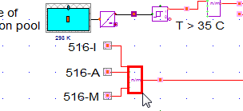
Running a pressure transient 1/3
BWR-model exercises
In this exercise the student will see a typical BWR plant response in a minor accident scenario caused by closure of the main steam isolation valves at full power. The valves are assumed to close by an inadvertent activation of the plant protection signal 516-A (main steam line rupture supervisory protection chain). Reactor scram due to 516-A is prevented. Do the exercise in the following order and answer the questions:
Describe briefly what you expect to happen in the accident scenario.
Open the trend window with the main parameters and run steady state for 10 s.
Prepare for the scenario by preventing signal 516-A (and 516-I and 516-M) to cause reactor scram. To do so go to net "516_ss_v" and exclude the choise component from simulation.

Slide 5
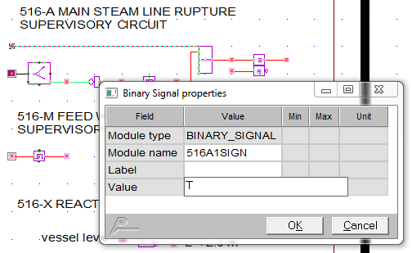
Running a pressure transient 2/3
BWR-model exercises
Go to net "516_e_i_tb_a_m_tsd" and activate manually 516-A isolation by changing binary signal 516A1SIGN from F to T.
Before starting the transient calculation change the Maximum time step and the Simulation time step from 0.1 to 0.001 s.
Increase also the number of minimum iterations to e.g. 7.
Check that the Grades trend plotting interval is small enough (0.01 s); In Grades choose: Tools -> Options -> Trend interval.

Slide 6
Running a pressure transient 3/3
BWR-model exercises
Run simulation for e.g. 5 seconds.
The transient phase of the scenario is fast. In order to see what happens zoom in the Grades trend window around the time where the transient starts. Look at the trend curves and monitors and check if the expectations on the plant response in step 1 are correct.
Reopen the model.
Run the transient again, now without preventing the scram signal from 516-A.
How do the results change?
+ Extra test: There is a 300 ms delay for 516-SS signal in net “354_reactor_scram”. Try setting this to e.g. 100 ms or 500 ms and repeat the simulation case without preventing the scram signal from 516-A once more.

Slide 7
Running Steam line break accident 1/4
BWR-model exercises
In this exercise the student will simulate a 200 % guillotine break in one steam line.
Describe briefly what you expect to happen in the accident scenario.
Define trends with interesting parameters to follow during the accident.
Run steady-state for a while.

Slide 8
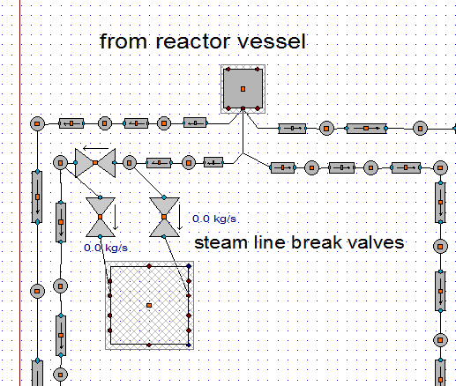
Running Steam line break accident 2/4
BWR-model exercises
A ready made break location is modeled in net “311_ste”. Break valves from both the reactor side and the turbine side are connected to the containment drywell. An auxiliary valve in the steam line is closed simultaneously as the break valves open.

Slide 9
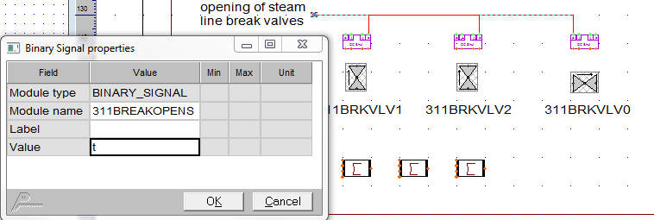
Running Steam line break accident 3/4
BWR-model exercises
Jump from one break valve to net “311_control”. The break valves are opened and the auxiliary valves are closed when signal 311BREAKOPENS is changed from F->T.
Before starting the transient calculation change the Maximum time step and the Simulation time step from 0.1 to 0.001 s.
Increase also the number of minimum iterations to e.g. 7.

Slide 10
BWR-model exercises
Running Steam line break accident 4/4
Check that the Grades trend plotting interval is small enough (0.01 s); In Grades choose: Tools -> Options -> Trend interval.
Run simulation for e.g. 5 seconds.

Slide 11
These commands increase dump steam line capacity
modi 413L506-PI300 PI12_AREA 0.172
modi 413L505-PI100 PI12_AREA 0.172
modi 413L506-PI305 PI12_AREA 0.172
modi 413L505-PI105 PI12_AREA 0.172
modi 413L508-PI400 PI12_AREA 0.172
modi 413L507-PI200 PI12_AREA 0.172
modi 413L508-PI405 PI12_AREA 0.172
modi 413L507-PI205 PI12_AREA 0.172
modi 413V509 VA12_AREA 0.344
modi 413V511 VA12_AREA 0.344
modi 413V509 VA12_PRESSURE_LOSS 3
modi 413V511 VA12_PRESSURE_LOSS 3

Slide 12
For tripping the feed water pumps:
Make a new input signal (Setpoint Binary) for OR-gate "445STPOR1". This can be used to trigger feed water pump trip. The signal also changes the boundary conditions in the feed water inlet (enthalpy and pressure).
For only decreasing feed water temperature (with a gradient):
Add a gradient component between 445LTSWI1 and 445LTBC1. Set gradient value for decrease to ??? 1/min. To decrease the temperature to ??? C, set analog signal 445LENT1S to ???.

